Slide 1

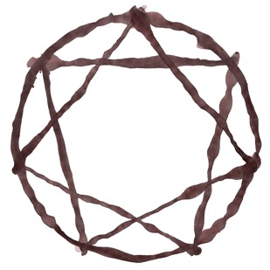
Fierce Compassion: an 8 week compassion focused acceptance & commitment therapy group
Dennis Tirch Ph.D.
Laura Silberstein-Tirch PsyD
Geoffrey Gold MA

Slide 2
Compassion Focused Therapy,
Acceptance and Commitment Therapy &
Compassionate Mind Training
Featuring materials from Dr. Paul Gilbert &
The Compassionate Mind Foundation

Slide 3
Fierce Compassion Materials for Research and Implementation –
Text: 845-664-1498
Email: VIP@mindfulcompassion.com

Slide 4



Slide 5
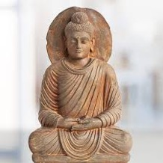
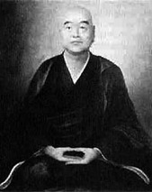
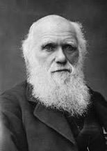
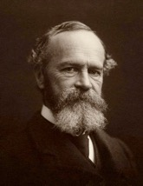
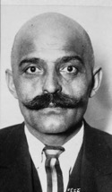
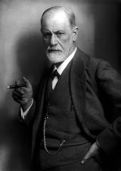
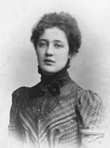
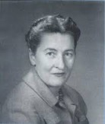
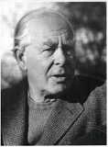
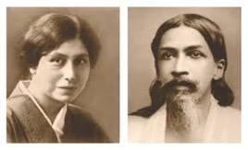
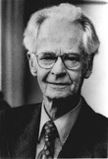

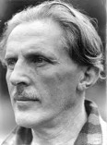
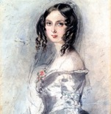

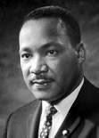
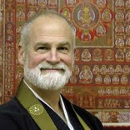
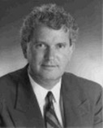





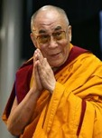
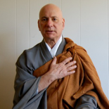


“New Circles Arise In Accordance With Need.”

Slide 6

Consent & Responsibility
Freely Chosen
Reversible
Informed
Enthusiastic
Specific

Slide 7
A Beginning Is Invisible

Slide 8
Fierce Compassion
Fierce Compassion training draws from - CFT, ACT, Mindful Self MSC, evolutionary science, and Zen Buddhism.
These influences emphasize the importance of relating to one another as fully present, vulnerable, and compassionate human beings.

Slide 9
Fierce Compassion
Psychological flexibility and our embodied motivation to give and receive care are key aspects in healing and awakening human potential.

Slide 10
Fierce Compassion
Fierce Compassion represents a wholehearted and courageous commitment to detecting and responding to suffering wherever it arises, while contributing to the wellbeing and liberation of all beings in all dimensions of our lives. Fierce compassion awakens and embodies the wisdom, strength and commitment that is our birthright.

Slide 11

Compassion Defined
“. . .a deep awareness of the suffering of oneself and of other living things, coupled with the wish and effort to relieve it.”
(Gilbert, 2009)

Slide 12
Two Psychologies of Compassion:
ENGAGEMENT

Slide 13
Two Psychologies of Compassion:
COURAGE & DEDICATION

Slide 14

Interacting Processes of Compassion
Compassion involves a series of interacting processes

Slide 15
Interacting Processes of Compassion
These processes can be trained

Slide 16

Interacting Processes of Compassion
This training can involve deliberate practice

Slide 17

Interacting Processes of Compassion
Shaping facilitates such practice

Slide 18
Skills
Imagery
Attention
Attributes
Reasoning
Sensitivity
Sympathy
Care
for
well-being
Distress tolerance
Compassion
Feeling
Behaviour
Non-Judgement
Empathy
Sensory

Slide 19

Compassionate Flexibility
Present Moment Sensitivity
Acceptance & Distress Tolerance
Care for Well Being
Empathy
(Self & Other)
Sympathy
(Self & Other)
Non-Judgement
Committed Compassionate Action

Slide 20
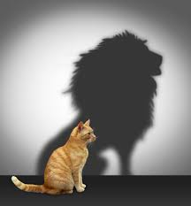
Courage
The mental or moral strength to venture, persevere, and withstand danger fear or difficulty
The ability and willingness to do something that you know is difficult or dangerous

Slide 21
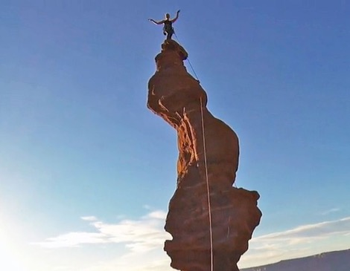
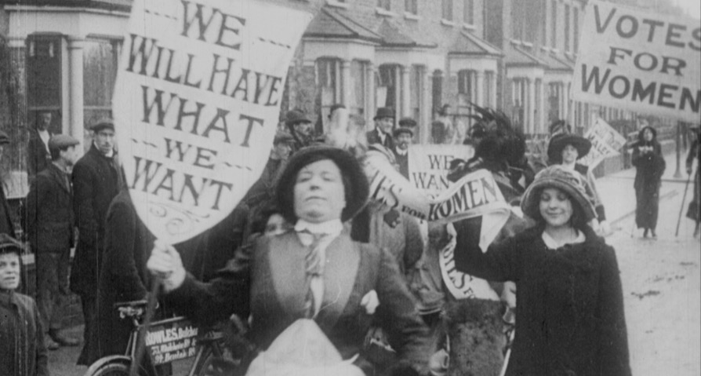

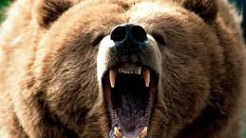
Notes:
Keisha thomas: you cant beat good into people

Slide 23
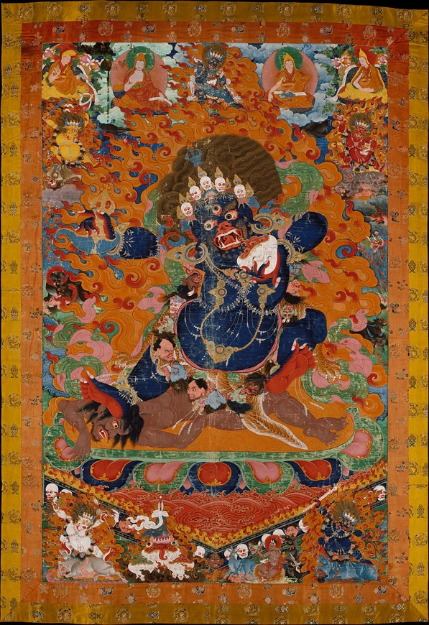

Slide 24
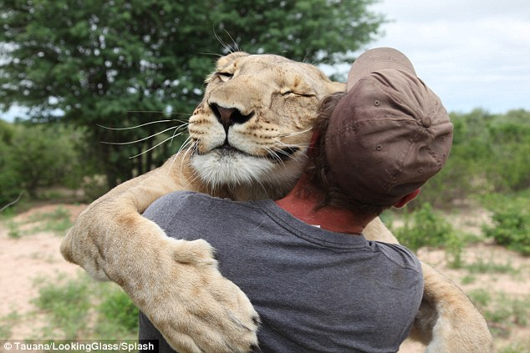
Because of great love one is courageous
“Being deeply loved gives you strength. Loving someone deeply gives you courage”
~ Lao Tzu

Slide 25
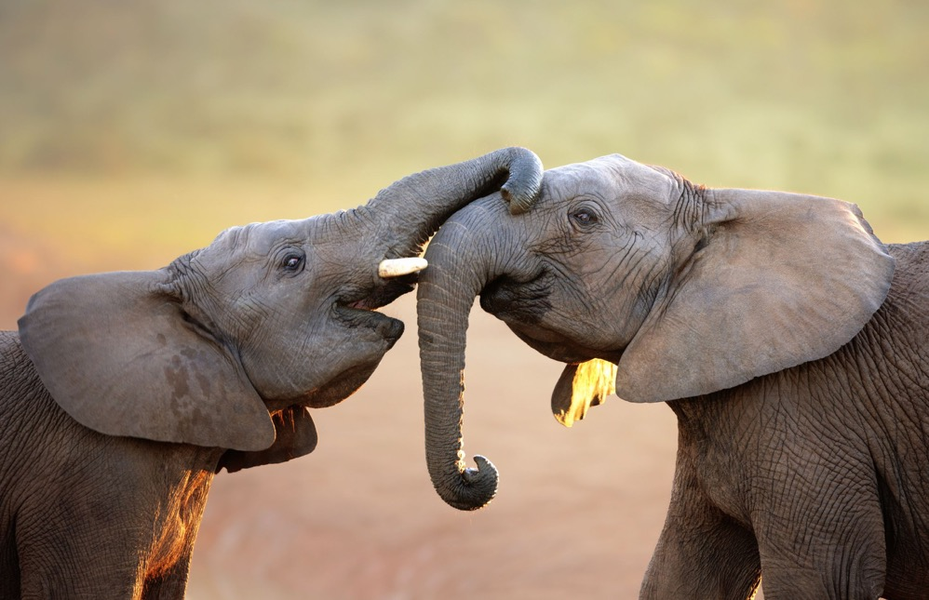
Training The Compassionate BodyMind

Slide 26

The Ocean of Being

Slide 27

The Reality Check –
“We come out of the world, not into it”
~ Alan Watts

Slide 28
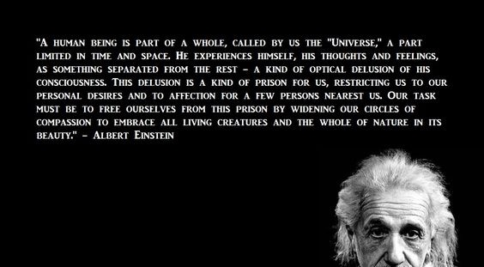
Letter from Einstein in 1950,
as quoted in The New York Times
(29 March 1972) and
The New York Post (28 November 1972).

Slide 29

Compassion begins with a
Reality Check
Regarding the nature of human suffering:
Evolutionary context
Our brains & bodies
Short & vulnerable lives
Cultural context & socially constructed self
(It’s a set up)

Slide 30


CFT Philosophy
We all just find ourselves here with a brain, emotions & sense of self we did not choose & are left to figure out
Life involves dealing with tragedies, inequity and suffering.
People do the best they can and we can do better
So much in life that cause our suffering is not of our design, not our choice & not our fault
However, it is our responsibility

Slide 31
Types of affect regulation systems
Driven, excited, vitality
Content, safe, connected
Incentive/resource- focused
Wanting, pursuing, achieving, consuming
Activating
Nonwanting/
Affiliative focused
Safeness, kindness
Soothing
Threat-focused
Protection and
Safety-seeking
Activating/inhibiting
Angry, anxious, disgusted

Slide 32
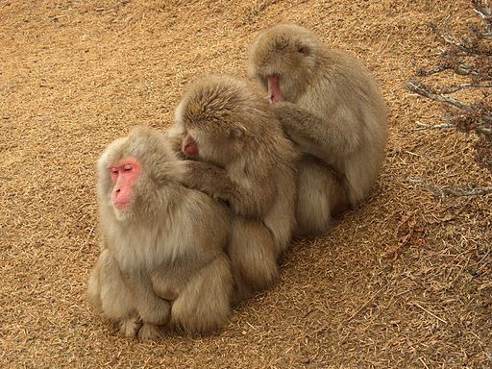

Slide 33
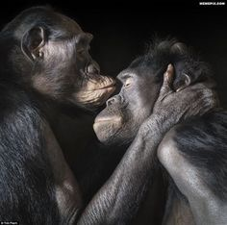

Slide 34
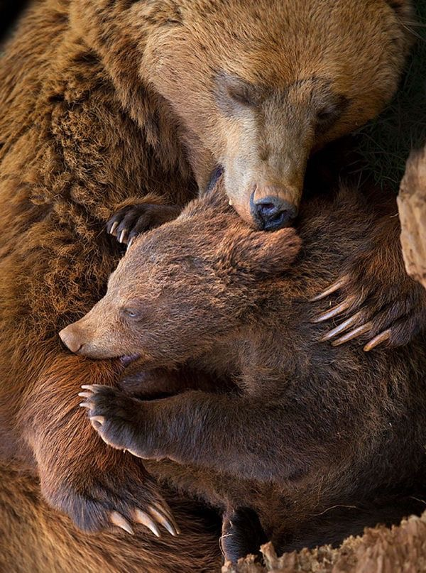
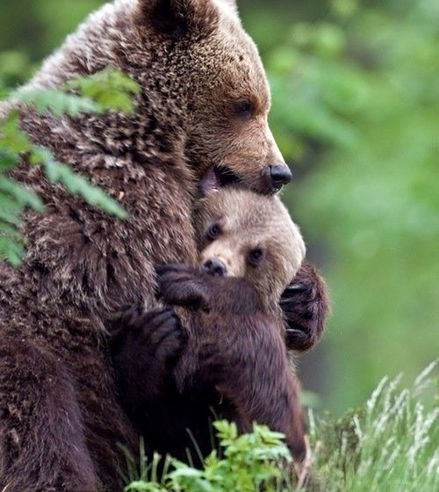

Slide 37


Slide 38


Slide 39


Slide 40
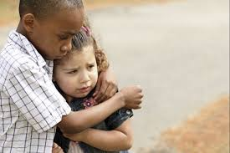

Slide 41


Slide 42
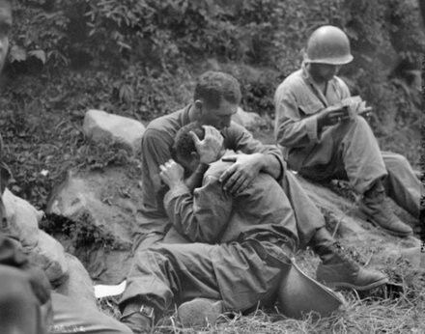

Slide 43
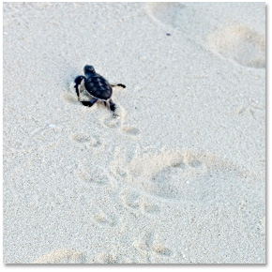
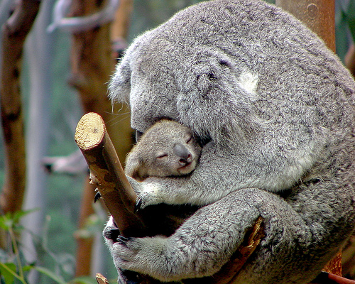


Slide 44
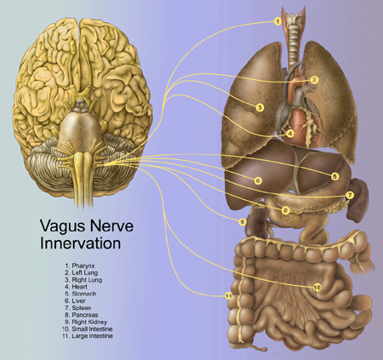
Safeness -connecting and the parasympathetic system: The Vagus Nerve
PNS influence on heart rate – slows beat down during outbreath
Associated with affiliation, tend & befriend, general positive emotional tone
Sensitive to safeness
Notes:
Emanating from the brainstem, the 10th cranial nerve, is the Vagus. The Vagus is affectionately referred to as the ‘wandering’ nerve – because it projects to so many parts of the body and is involved in a range of functions, as depicted by the yellow lines here. The Vagus nerve functions I would like to focus on – which have to do with mindfulness at the 2 and 3 levels, are it’s influence on heart rate, and it’s role in affiliative states. The yellow line that terminates on a number 4 – represents a shockingly important process – the Vagus nerve imparting parasympathetic influence on heart rate – that is – slowing the heart down. Without vagal input, your heart would beat unsustainably fast to your mortal demise. There is a rich scientific literature on this process, measuring the ratio of heart rate during inhale (driven by sympathetic input) and that during exhale (vagal input) – yielding a measure called Vagal Tone. Vagal Tone, it turns out, is predictive of a host of benefits: calm behavioral states, being better at relating to emotional experiences in a healthy way (a property often called resilience), generally experiencing more positive than negative emotional states, lower blood pressure, and more. Mindfulness practice has been shown to strengthen vagal tone (Ditto, McGill, Annals of Behavioral Medicine). That said, thinking about mindfulness & compassion, the capacity of vagal tone to adapt to environmental changes (e.g., physiological, cognitive or psychological challenges) defined as vagal flexibility, e.g. high vagal flexibility allows sympathetic activity to occur and limits efficiently the stress period to the stressors presence may be the measure of importance. Studies have shown that vagal recovery may be more strongly associated with mindfulness than vagal tone alone.
The second function I’d like to touch upon comes from a pioneering scientist named Steve Porges, author of the PolyVagal theory – which suggest that a primary funciton of the Vagus nerve is to support affiliation and the formation of social ties that lead to long term relationships. Coming from a functional biological perspective, Porges suggests that the Vagus nerve’s visceral input to the brain, support of vocal fluctuations and parasympathetic influence drives people to approach others for cooperative gain, to communicate in close proximity, and develop dependencies. An entire field has emerged from Porges’s – including work by Dacher, Stepahie Brown, and others. A key part of the story here is that vagal influence is exxentially silenced by fear, vigilance to threat, anxiety, etc…
An emerging science on the study of MindWandering – that is – absentmindedly thinking about what’s not happening right now – is deleterious to happiness – engages systems that typically track thoughts about the self: what happened, what might happen, and why they might not like me…a style of reflexive thinking for which mindfulness is pointedly an antidote.

Slide 45

Brahmaviharas - Immeasurables
  Karuna (compassion)
  Metta (loving-kindness)
  Mudita (sympathetic joy)
  Upeekha (equanimity)

Slide 46

The arising motivational imperative, known as bodhicitta (awakened heart) is a major foundation of Buddhist practice.
The Awakening Heart

Slide 47
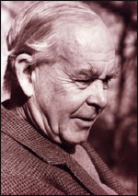
Bowlby & Ainsworth
Attachment defined as "lasting psychological connectedness between human beings.”

Slide 48
Bowlby & Ainsworth
Prosocial and affiliative behaviors related to self and others that emerge from our attachment history are major regulators of threat processing and functioning

Slide 49
Bowlby & Ainsworth
Set of behaviors that involve the coordination and action of multiple instinctive systems.

Slide 50
Bowlby & Ainsworth
The primary proximal function of each instinct is the maintenance of proximity to the child’s primary caregiver. (Beks, Ljzermzan & Tots, 2015)

Slide 51
Bowlby & Ainsworth
This develops into an ability to flexibly persist towards or break off from the pursuit of a goal based on homeostatic experiences that are related to survival likelihood

Slide 52
Bowlby & Ainsworth
Social signals are the drivers (social mentality)
Lack of these in early life can seriously disrupt motivation, emotion and self regulation systems

Slide 53
Bowlby & Ainsworth
Proximity seeking – desire closeness, to be with
Secure base – source of security and guidance to go out, explore and develop confidence
Safe haven – source of comfort and emotion regulation

Slide 54
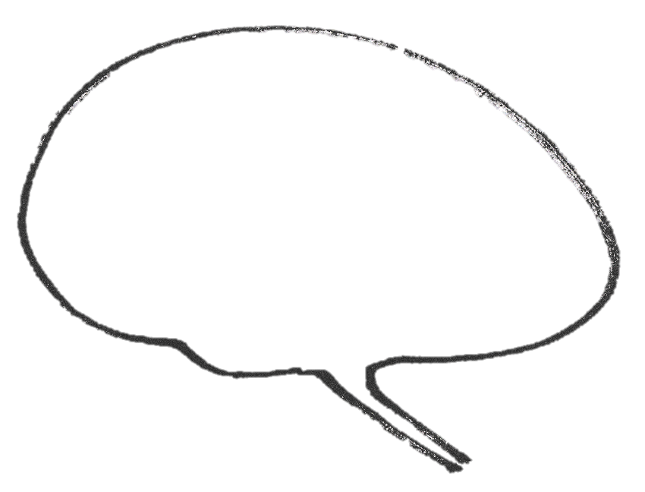
Self-self, others to self, and self to other
Calms/encourages
Threat
Affiliative/ Soothing
Proximity, secure base and safe haven

Slide 55
Maturation of Affiliative Processing
Proximity, secure base, safe haven
Self-affiliation –experiences a lovable self
Calms/encourages
Threat
Affiliative/ Soothing
Internal representations of helpful others and sources of comfort
Neurophysiological networks
Emotional memories of soothing

Slide 56

Attachment and Response Flexibility - Seigel
The prefrontal mediation of response flexibility involved in secure attachment dynamics involves a coordinated process . . .

Slide 57
Attachment and Response Flexibility - Seigel
Incorporating sensory, perceptual, and appraisal mechanisms and enabling new and personally meaningful responses to be enacted

Slide 58

Attachment and Response Flexibility - Seigel
May allow us to approach life decisions, relationships, and narrative responses with self-reflection and with a sense of perspective on past, present, and future contingencies.

Slide 59

Attachment &
Psychological Flexibility
A radically embodied attachment dynamic influences physical homeostasis and capacity for adaptive responding without a need for a hypothesized activation of representational networks
(Becks, Ljerman & Tops, 2015)

Slide 60
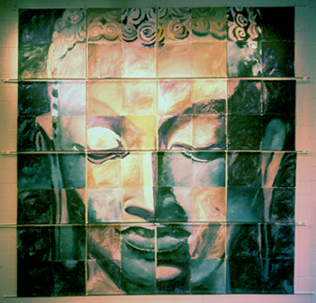

Psychological Flexibility
“It is defined as the ability to fully contact the present moment and the thoughts and feelings it contains without needless defense, and, depending upon what the situation affords, persisting or changing in behavior in the pursuit of goals and values.” (Hayes, et. al., 2006)

Slide 61
Compassion & Psychological Flexibility
Willingness to experience difficulty or suffering & Acceptance of reality as it is
A Sensitivity to the present moment & mindfully observing our self-evaluative, distressing and shaming thoughts without allowing them to dominate our behavior or our states of mind
Nonjudgmental observing & defusion
An understanding of both one’s pain and one’s values
Flexible perspectives towards a broader, transcendent sense of self
Committed engagement in our life’s pursuits, fully, with self-kindness and self-validation
(Hayes, 2008; Dahl, Plumb, Stewart & Lundgren; 2009)

Slide 62
Psychological Flexibility
Present Moment Contact
Acceptance
Values Authorship
Psychological Flexibility
Defusion
Commitment
Self-As-Context

Slide 63
Compassionate Flexibility
Sensitivity
Distress Tolerance
Care For Well-Being
CompassionateFlexibility
Commitment to Compassionate Behavior
Non-Judgment
Sympathy,
Empathy

Slide 64
Compassionate Flexibility
Present Moment Sensitivity
Acceptance & Distress Tolerance
Care for Well Being
Compassionate
Mind
Empathy
(Self & Other)
Sympathy
(Self & Other)
Non-Judgement
Committed Compassionate Action

Slide 65
Compassionate Flow

Slide 66
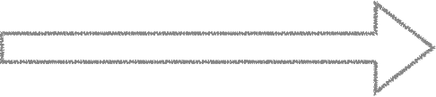
Compassionate Flow
Self
Other

Slide 67
Compassionate Flow
Self
Self

Slide 68
Compassionate Flexibility
Present Moment Sensitivity
Acceptance & Distress Tolerance
Care for Well Being
Compassionate
Mind
Empathy
(Self & Other)
Sympathy
(Self & Other)
Non-Judgement
Committed Compassionate Action

Slide 69
Compassionate Flow

Slide 70
Compassionate Flow
Self
Other

Slide 71
Compassionate Flow
Self
Self

Slide 72
Compassionate Flexibility
Present Moment Sensitivity
Acceptance & Distress Tolerance
Care for Well Being
Compassionate
Mind
Empathy
(Self & Other)
Sympathy
(Self & Other)
Non-Judgement
Committed Compassionate Action

Slide 73
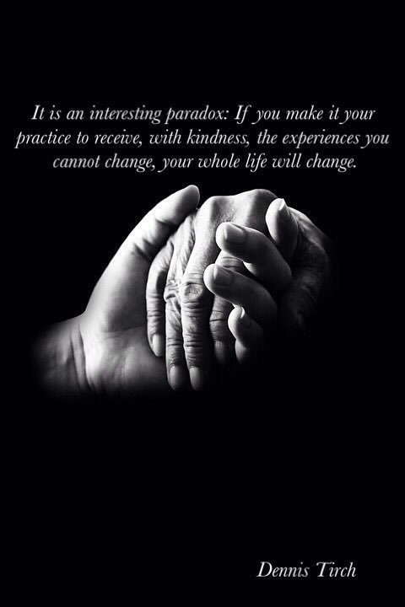
Compassion Focused Therapy
Core Therapeutic Techniques:
Embodiment/Relational
  Flow of compassion in and out
  Body posture/state/expression
  Micro-skills
  Empathic Bridging
  Affect Matching
  Socratic Questions
  Guided Discovery
  Social Reinforcement
  Work with 12 competencies of compassion

Slide 74

Training the Compassionate Mind
Embodiment of Compassion/Modeling of Compassion
Therapeutic relationship
  Therapist as social reinforcer
  Functional Analysis in 3 Dimensions
Specific techniques in therapy
Self-therapy practice
  Self practice/self reflection
Compassionate mind training (CMT)

Slide 75
Compassion Focused Therapy
Core Therapeutic Techniques:
  Compassionate Mind Training
    Soothing Rhythm Breathing
    Ocean of Being
    Compassionate Color
    Safe Space
    Compassion Flowing in
    Compassion Flowing out
    Compassionate Other
    Compassionate Self
    Compassionate Self and Multiple Selves
    Spheres of Awareness
    Flow of Life

Slide 76
Compassion Focused Therapy
Techniques:
    Case formulation – attachment history
    Case formulation – Compassionate Mind Interview
    Reality Check
    Three Circles
    Compassion Competencies
    Multiple Selves
    Functional Analysis of Self-Criticism
    Letter Writing
    Role Play
    Dyadic Work
    Chair Work
    Compassionate Flexibility Training

Slide 77
Compassion Focused Therapy
Core Therapeutic Processes:
Differentiation
Feeling Safeness
Psychological Flexibility
Integration
Transformation

Slide 78

Session 1 Overview
Session | Learning Objectives | Discussions | Exercises
Introduction to Fierce Compassion & Present Moment Sensitivity | Compassionate Flexibility 7-point model Mindfulness Mind Awareness | 1.1 Workability 1.2 Fierce Compassion: 7 processes for compassionate flexibility 1.3 Nature of the mind: Compassionately contacting the present moment | 1.1 Invisible Beginning: Mindful Breathing 1.2 Soothing Rhythm Breathing 1.3 Ocean of Being

Slide 79
Session 2 Overview
Session | Learning Objectives | Discussions | Exercises
Care for Well-Being | Values and valuing Motives and emotions Loving-kindness | 2.1 Motivational Systems and Three Circle Model 2.2 Motive to Care and Compassionate Values 2.3 Setting personal aims and motivations | 2.1 Sitting inside significant questions 2.2 Loving-Kindness Meditation 2.3 Values Authorship - What do you want your life to stand for?

Slide 80
Session 3 Overview
Session | Learning Objectives | Discussions | Exercises
Building Willingness | Experiential Acceptance Distress Tolerance | 3.1 Creative Hopelessness 3.2 Reality Check and Wisdom of No Blame 3.3 Embodiment | 3.1 MCA: Mindfulness, Compassion, Acceptance 3.2 Creating a Safe Place 3.3 Intentional Discomfort

Slide 81
Session 4 Overview
Session | Learning Objectives | Discussions | Exercises
Nonjudgment | Defusion Equanimity Compassionate thinking Additive reappraisal | 4.1 Observing thoughts with the compassionate mind 4.2 Compassionate Thinking 4.3 Letter from compassionate self and inner critic | 4.1 Defusion through distancing “Externalizing the Thought” 4.2 Defusion through Immersion “Dropping In” 4.3 Self- Compassion Break

Slide 82
Session 5 Overview
Session | Learning Objectives | Discussions | Exercises
Sympathy | Evolved response to Suffering Attachment Common Humanity | 5.1 Attachment, Soothing, and Affiliative Emotions 5.2 Common Humanity | 5.1 Sweet Spot 5.2 Postures, facial expression, voice tones 5.2 Compassion Flowing In

Slide 83
Session 6 Overview
Session | Learning Objectives | Discussions | Exercises
Empathy | Self-as-context Flexible Perspective-taking | 6.1 Self-as-context and deictic framing 6.2 Empathic resonance as relational framing | 6.1 Cultivating the Observer Self and Compassionate Intention 6.2 Multiple Self Technique 6.3 Three Chair Technique for Inner Critic

Slide 84
Session 7 Overview
Session | Learning Objectives | Discussions | Exercises
Committed Compassionate Action | Attributes of the Compassionate Self Courage Exposure | 7.1 Wisdom, Strength, and Commitment 7.2 Using Imagery | 7.1 Compassionate Other Imagery 7.2 Fierce Compassion Self 7.3 Courage Exposure

Slide 85
Session 8 Overview
Session | Learning Objectives | Discussions | Exercises
Conclusion: Compassionate Commitment | Formal practices Living a compassionate life Conclusion: New Beginnings | 8.1 Creating a formal meditation practice 8.2 Letter writing for future groups | 8.1 Many Faces of Compassion 8.2 Embodying the Compassionate Ideal 8.3 Invisible Completion/Remembering Basic Goodness

Slide 86
Compassionate Flexibility
Present Moment Sensitivity
Acceptance & Distress Tolerance
Care for Well Being
Compassionate
Mind
Empathy
(Self & Other)
Sympathy
(Self & Other)
Non-Judgement
Committed Compassionate Action

Slide 87

Playing The Octave

Slide 88
Compassionate Flexibility | Signals or Indicators | Guided Discovery or Transitions
Sensitivity | Narrow or inflexible attention | Where or how does that feel in your body? Where is your attention pulled? What part are you focused on the most?
Distress Tolerance | Avoidance Rumination | What part of this are you least willing to feel?
Non Judgment | Literality of private events; “word prisons” (should, never, must, always…) | If that were true, what would be your biggest fear? If I could take that away what would you be afraid of happening? How old is that? What would your compassionate self say about…?

Slide 89
Compassionate Flexibility | Signals or Indicators | Guided Discovery or Transitions
Flexible perspectives (Sympathy Empathy) | Lack of presence or perspective taking | What part of you is noticing this? If I were you and you were me, what would you be thinking/feeling about this? Imagining child self
Care for well being | Reduced or lack of caring behaviors, lack of motivation to care | If that were the case, what would you have to stop caring about for this not to bother you? Miracle questions/Values authorship.
Commitment to prevent or alleviate suffering | Impulsivity or stagnation Emotional or rule governed behavior | What is it that you are not doing that would move you in that direction? Could we come up with a practice that will help you embody and act on this? To care for & protect your well-being?

Slide 90
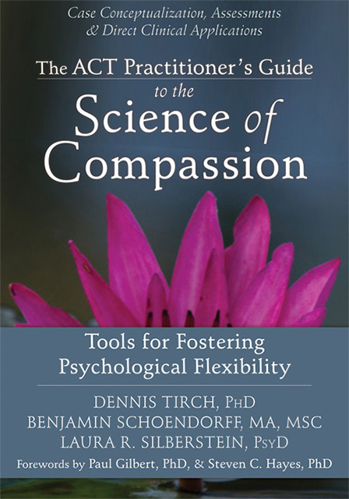
MINDFULCOMPASSION.COM

Slide 91
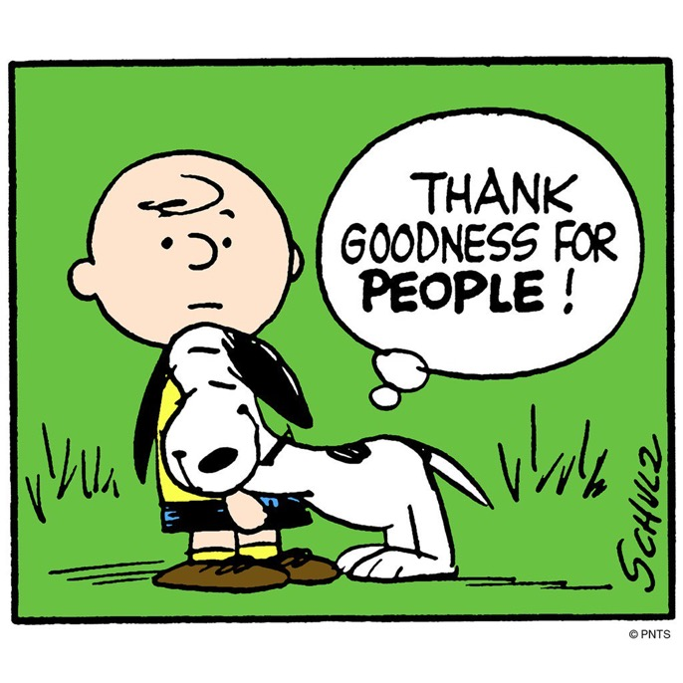
Thank you for being you and being here!

